Slide 1
Modeling the Impact of Sleep Variables on Cognitive Function and Brain Structure in AD Cohort
Mr. Anirudh Sowrirajan Dr. Ajay Kumar Nair

Slide 2
Goal of the Study
AD is a progressive neurodegenerative disorder and the most common cause of dementia.
While genetic predispositions like APOE4 play a key role, modifiable risk factors account for an estimated 40-45% of the disease burden and offer a crucial opportunity for intervention or delay in the progression.
Sleep disturbances are increasingly recognized as both early indicators and potential contributors to AD pathology.
Clinical sleep disorders like insomnia, sleep apnea, restless legs syndrome, and other sleep related disorders such as parasomnia, hypersomnia,. Etc.
Subjective sleep quality and severity over time.
The aim of this study is to evaluate the influence of sleep-related variables on cognition and MRI measures using cross-sectional and longitudinally.
Outcome variables:
Cognitive functions (Memory, Executive function, Language, Visuospatial function)
MRI volumetric features (31 regions)
Key predictors:
Sleep disturbances and severity (Both cross-sectional and longitudinal)
Covariates controlled:
Sociodemographic features (Ethnicity, Race, Age, Gender, Marital status)
Clinical relevance (BMI, APOE4 status, medical history)

Slide 3
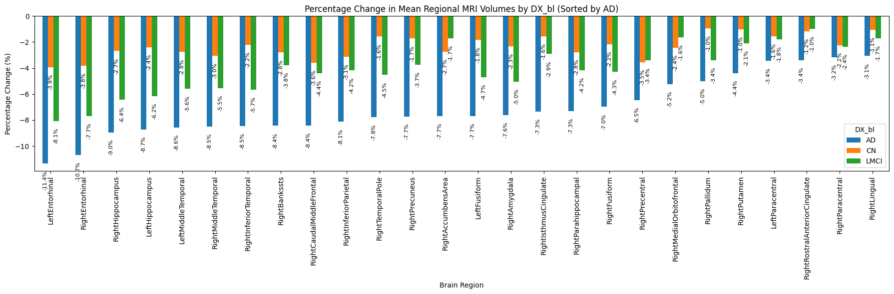
Mean Volume Differences between different Baseline Diagnosis

Slide 4
Data Selection
ADNI (Alzheimer’s Disease Neuroimaging Initiative) was chosen for their availability of longitudinal study.
Individuals: 522 Follow-ups: 4 (baseline, month 6, 12, 24) Samples: 2088 Features: 54 Multimodal features
SL.NO | Category | Features
1 | Patient's Demographics | Age, Education, Ethnicity, Race, Gender, Marital Status
2 | Genotype Data | APOE4 status
3 | Clinical Data | BMI, Diagnosis status, Medical history (psych, neural, cardio, resp)
4 | Cognitive Assessment Data | Memory, Language ,Visuospatial and Executive Function assessments
6 | Structural MRI Volumetric Data | Regional Brain Volumes based on Desikan-Killiany atlas (31 features)
7 | Sleep Data | Disorder history (insomnia, restless legs, osa), Sleep quality, quality severity

Slide 5
Approach
Preprocessing
ICV-normalized MRI volumes used to ensure correct for people with bigger heads
Correlation Analysis:
Pearson correlation was conducted between (Sleep <-> Cognitive outcomes) (Sleep <-> MRI volumetric outcomes) (Sleep <-> Sociodemographic features)
Stratified by diagnosis: CN, MCI, AD at baseline
Top 10 volumetric regions were visualized using a heatmap
Granger’s Causality: Directional testing: (Sleep -> Outcome) (Outcome -> Sleep)
Cross-Sectional Analysis:
Ordinary Least Squares (OLS) regression models were used: (Outcome = Sleep variable + Sociodemographic covariates)
Separate models for Cognitive outcomes and MRI volume outcomes
Model variants include: (Sociodemographic) (Sociodemographic + APOE4, BMI and medical history)
Longitudinal Analysis:
Linear Mixed Effects Models (LMMs) were used: Captured within-subject variability over time using random effects (RID)
Included adjusted age as a time-varying covariate
Note: FDR Correction applied to all p-values for multiple comparison control

Slide 6
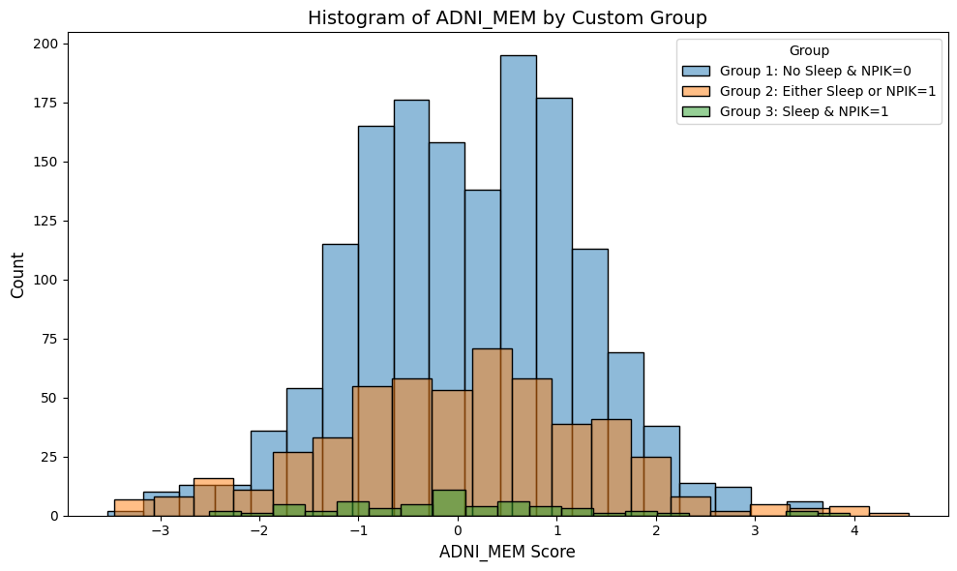
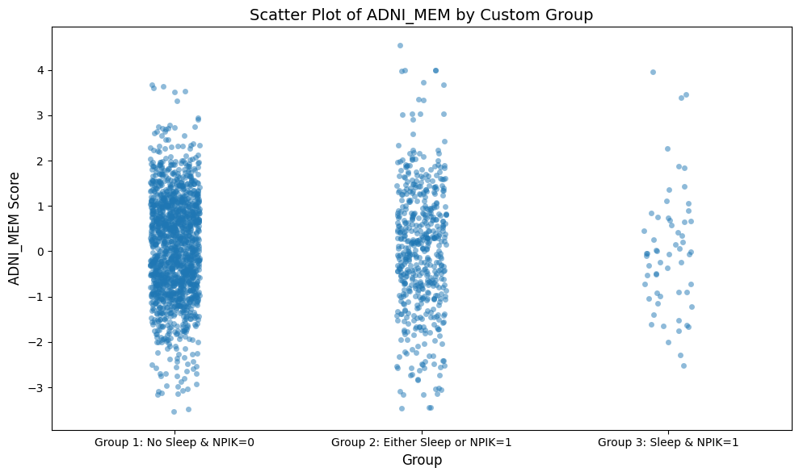
Potential Influence of Sleep Variables
Sleep history variables (Baseline, N = 522)
Interpretation: Prevalence is low, presence may have not have direct effect
Longitudinal Sleep Variables (4-timepoints)
Gradual increase in severity over time
Relevance
Poor sleep quality impairs glymphatic clearance, promoting amyloid-beta and tau accumulation
Fragmented sleep is linked to Enhancing neuroinflammation and oxidative stress
Variable | Present (1) | Absent (0) | Description & Relevance
Sleep Apnea | 39 | 483 | Linked to nocturnal hypoxia, neuronal stress, hippocampal atrophy.
Restless Legs Syndrome | 10 | 512 | Associated with dopaminergic dysfunction, poor sleep quality, daytime fatigue.
Insomnia | 33 | 489 | Chronic insomnia correlates with amyloid deposition.
Other Sleep Disturbance | 7 | 515 | Includes hypersomnia, parasomnias; often comorbid with neurodegeneration.
Timepoint | No Disturbance (0) | Mild (1) | Moderate (2) | Severe (3)
BL | 459 | 48 | 13 | 2
M06 | 439 | 57 | 22 | 4
M12 | 428 | 58 | 31 | 5
M24 | 433 | 50 | 29 | 10

Slide 7
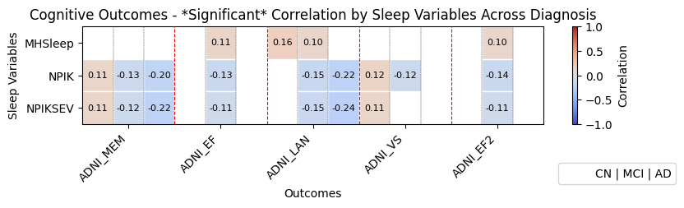
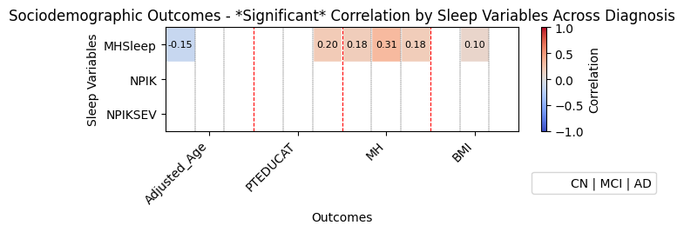
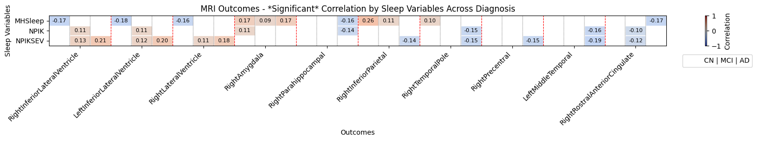
Correlation Analysis

Slide 8
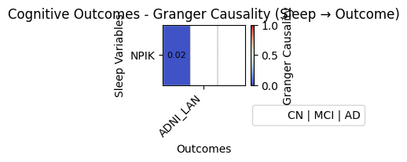
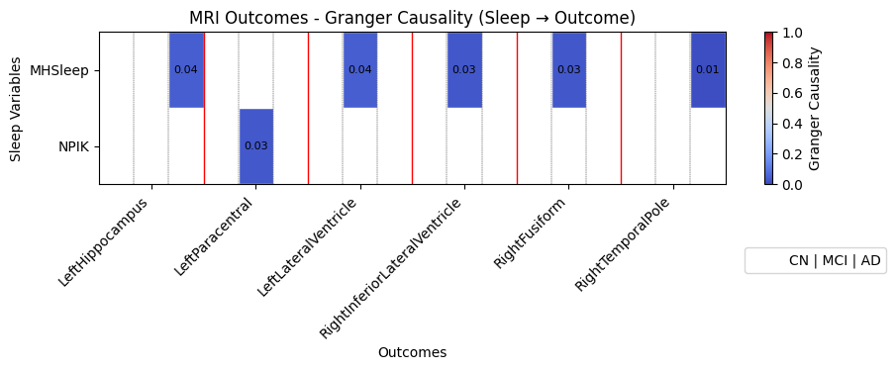
Causality Analysis (Sleep → Outcome)

Slide 9
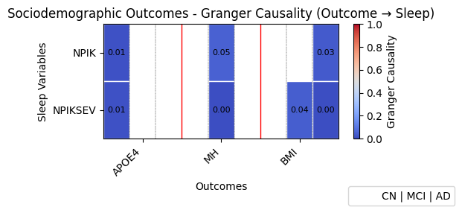
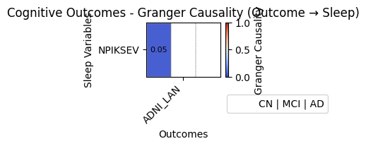
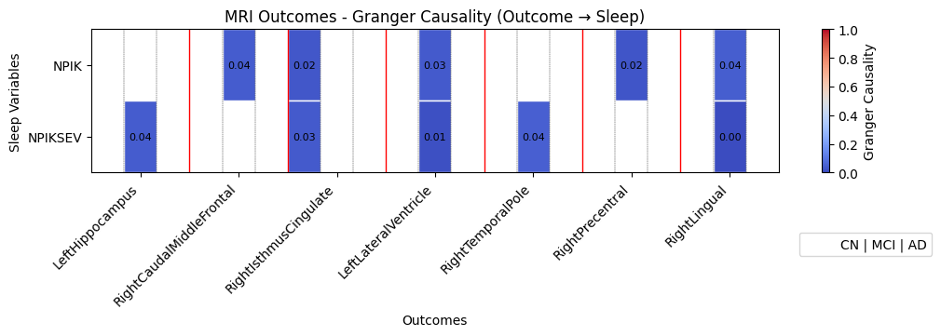
Causality Analysis (Outcome → Sleep)

Slide 10
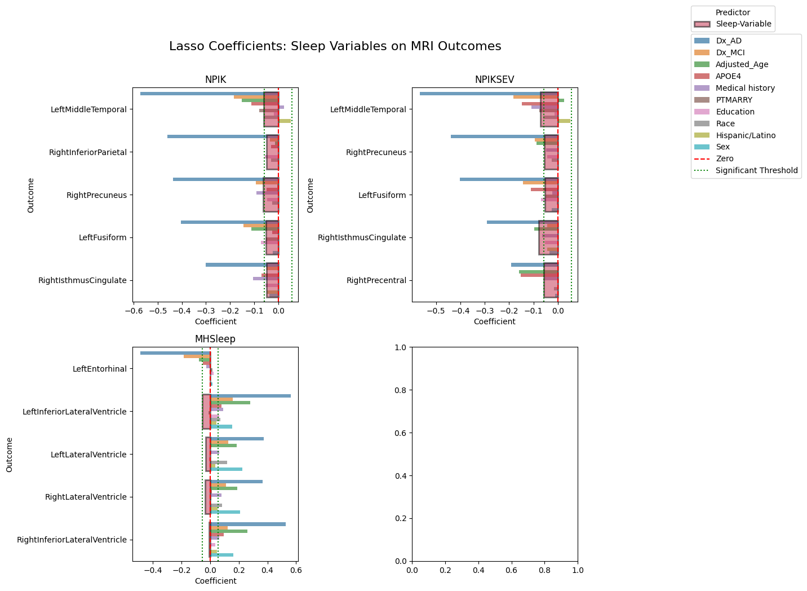
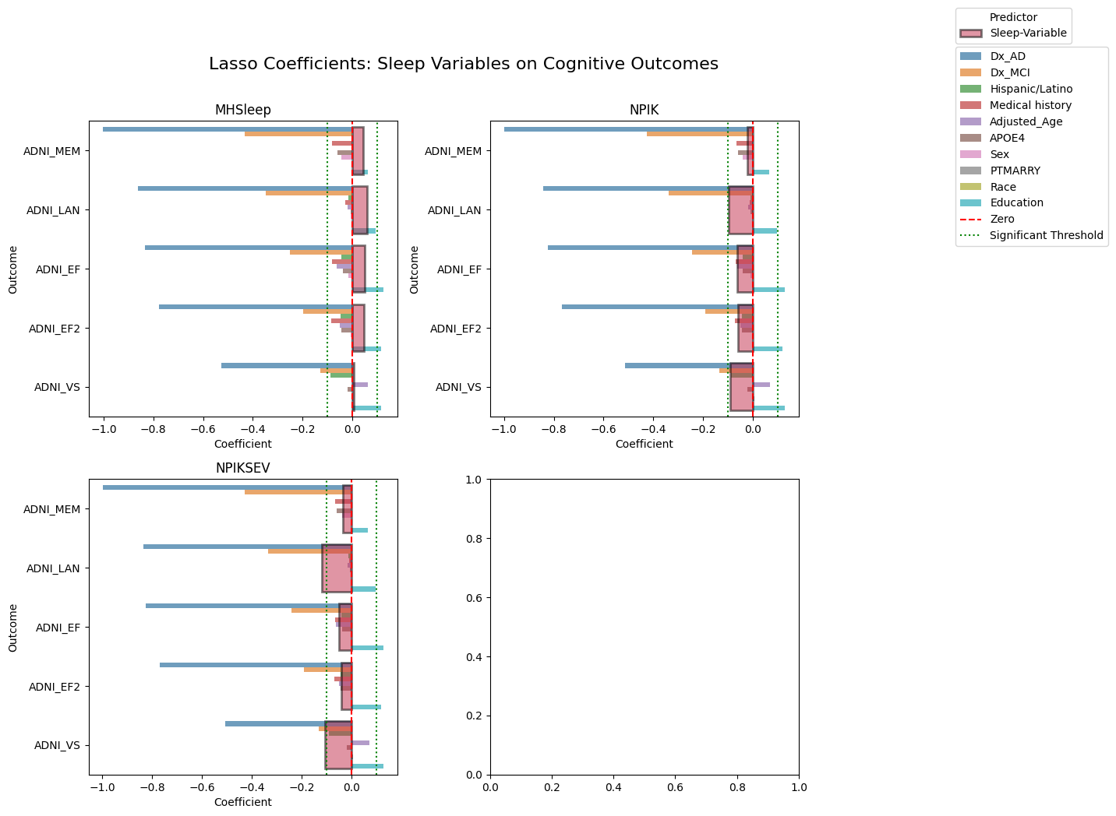
Cross-sectional Analysis

Slide 11
Summary
Correlation Analysis:
Cognitive burden is most consistently associated with NPIK and NPIKSEV, affecting memory.
Sociodemographic ties suggest that medical history and BMI may mediate the impact of sleep disorders.
Sleep disturbances affected people with AD the most.
Causality Analysis:
Sleep variables affected each outcome on people with either AD or MCI. (CN people are least affected)
APOE4, BMI and medical history modestly predict later sleep quality issues.
Among cognitive outcomes, language shows the most predictive capacity.
Cross sectional Analysis:
All Sleep variables show negative coefficients across all cognitive domains except for the sleep disorder variable.
Sleep disturbances affected Language outcome the most.
Sleep disorders (MHSleep) doesn’t affect the mri outcomes much as NPIK or NPIKSEV.

Slide 12
Significance
 | MHSleep | NPIK | NPIKSEV
LeftEntorhinal | — | 0.071 | —
LeftFusiform | 0.126 | -0.179 | -0.107
LeftHippocampus | 0.136 | 0.055 | -0.009
LeftInferiorLateralVentricle | -0.130 | 0.098 | 0.163*
LeftLateralVentricle | -0.111 | 0.094 | 0.114
LeftMiddleTemporal | 0.111 | -0.182 | -0.125*
LeftParacentral | 0.113 | -0.114 | -0.095
RightAccumbensArea | 0.204* | 0.054 | -0.015
RightAmygdala | 0.183* | 0.288* | 0.145*
RightBankssts | 0.112 | — | —
RightCaudalMiddleFrontal | — | — | —
RightEntorhinal | — | 0.093 | —
RightFusiform | 0.278* | -0.132 | -0.074
RightHippocampus | 0.114 | 0.146 | 0.039
RightInferiorLateralVentricle | -0.056 | 0.109 | 0.184*
RightInferiorParietal | 0.275* | -0.173 | -0.104
RightInferiorTemporal | 0.221* | -0.084 | -0.057
RightIsthmusCingulate | 0.164 | -0.176 | -0.149*
RightLateralVentricle | -0.117 | 0.149 | 0.154*
RightLingual | — | — | —
RightMedialOrbitofrontal | 0.208* | -0.126 | -0.081
RightMiddleTemporal | 0.088 | -0.096 | -0.077
RightPallidum | — | — | —
RightParacentral | — | -0.089 | -0.096
RightParahippocampal | — | — | -0.053
RightPrecentral | 0.100 | -0.166 | -0.123
RightPrecuneus | 0.190 | -0.223* | -0.113
RightPutamen | 0.238* | 0.066 | —
RightRostralAnteriorCingulate | — | -0.169 | -0.090
RightTemporalPole | 0.116 | — | —
* = P<0.05 Top 3 MRI volumes were taken both with positive and negative coefficients
 | NPIK | NPIKSEV | MHSleep
ADNI_EF | -0.20 (p=0.03)* | -0.10 (p=0.08) | 0.16 (p=0.06)
ADNI_EF2 | -0.21 (p=0.03)* | -0.09 (p=0.13) | 0.16 (p=0.07)
ADNI_LAN | -0.30 (p=0.00)* | -0.20 (p=0.00)* | 0.19 (p=0.04)*
ADNI_MEM | -0.09 (p=0.26) | -0.07 (p=0.14) | 0.14 (p=0.05)
ADNI_VS | -0.28 (p=0.02)* | -0.19 (p=0.01)* | 0.07 (p=0.46)

Slide 13
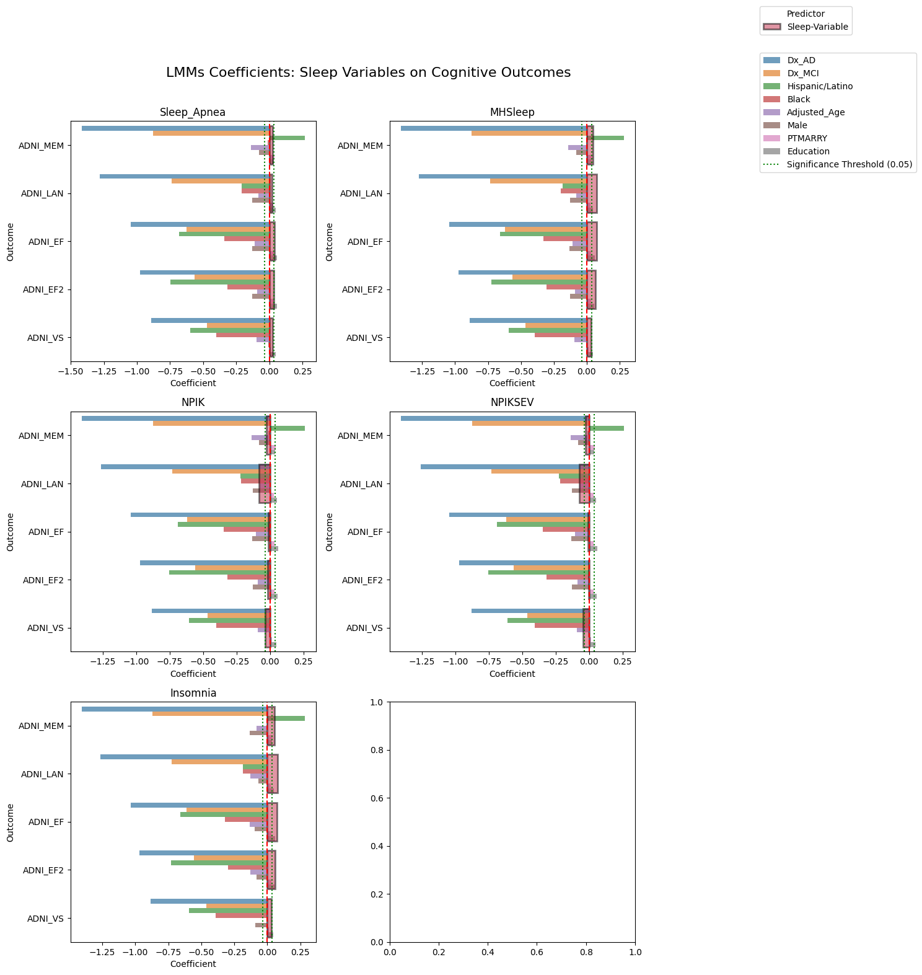
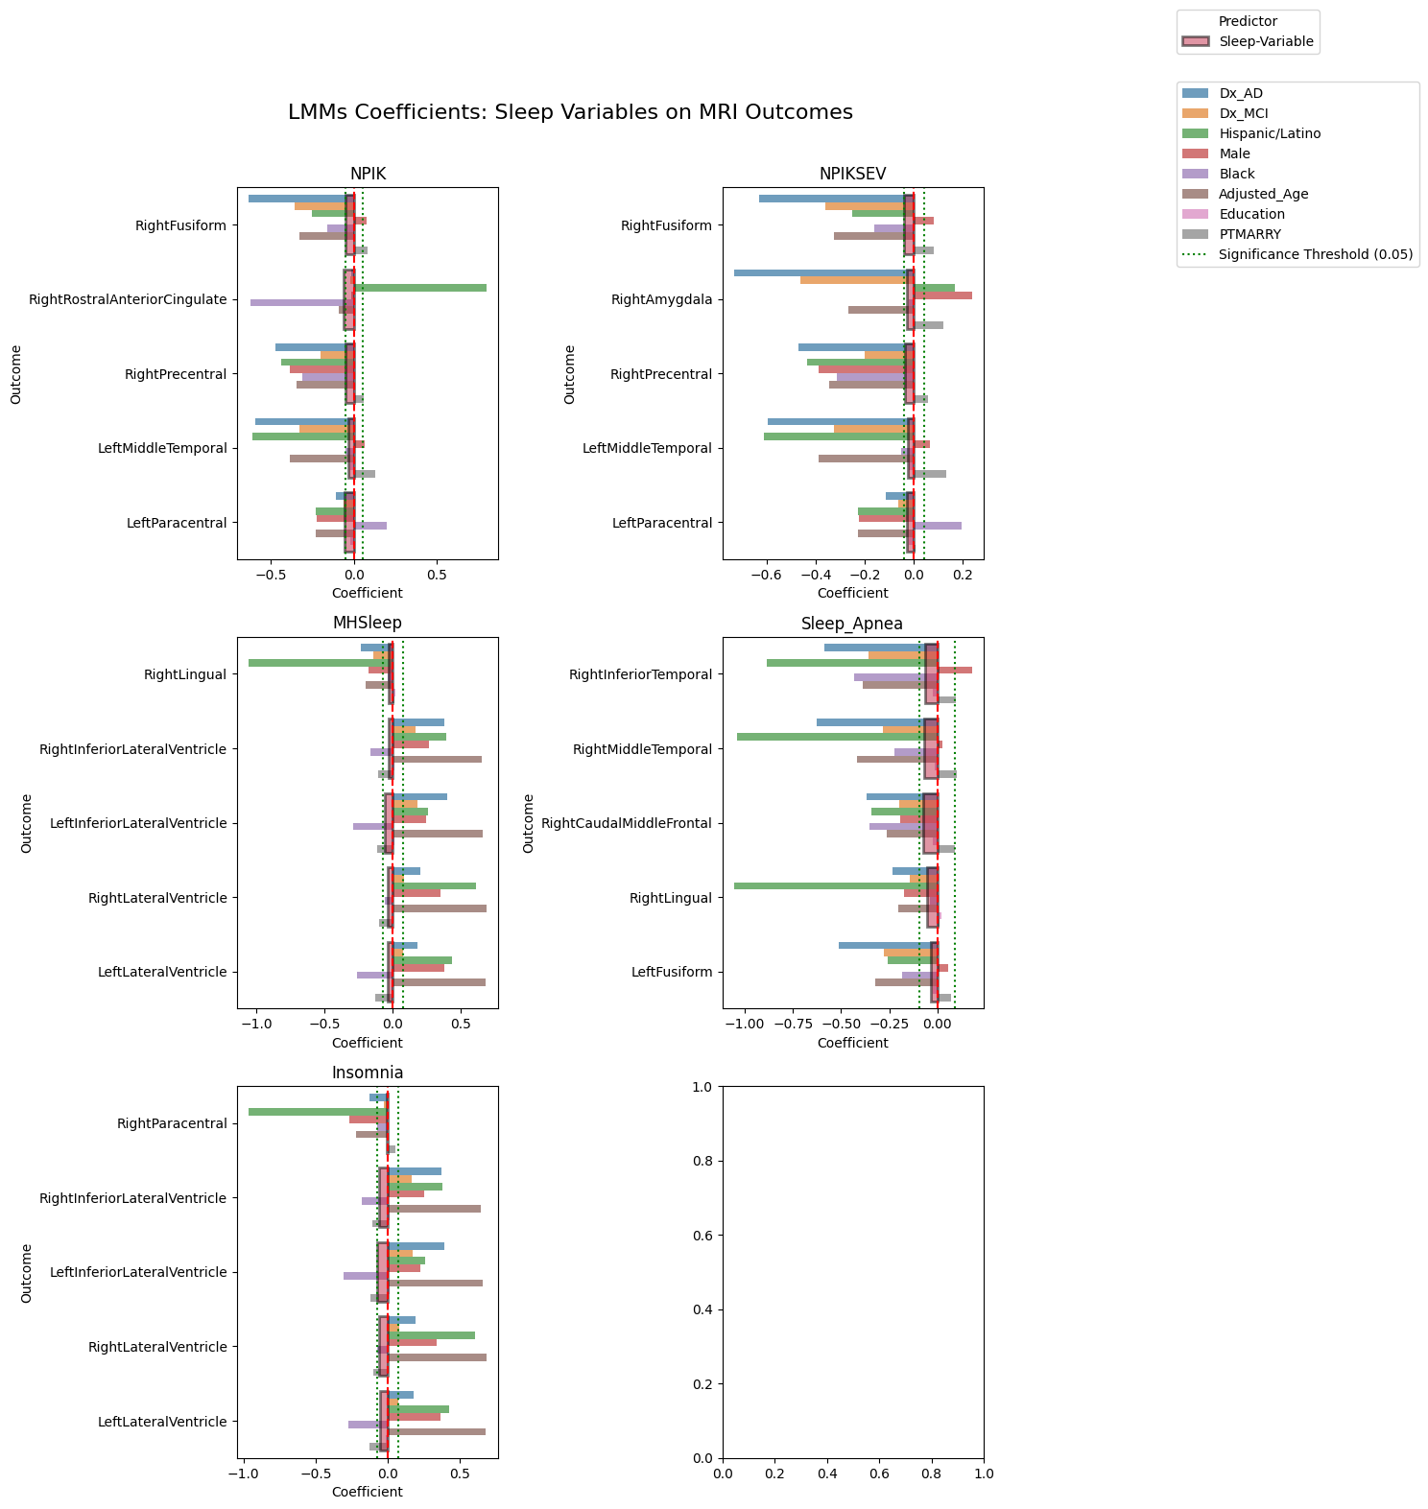
Longitudinal Analysis (Model-1)

Slide 14
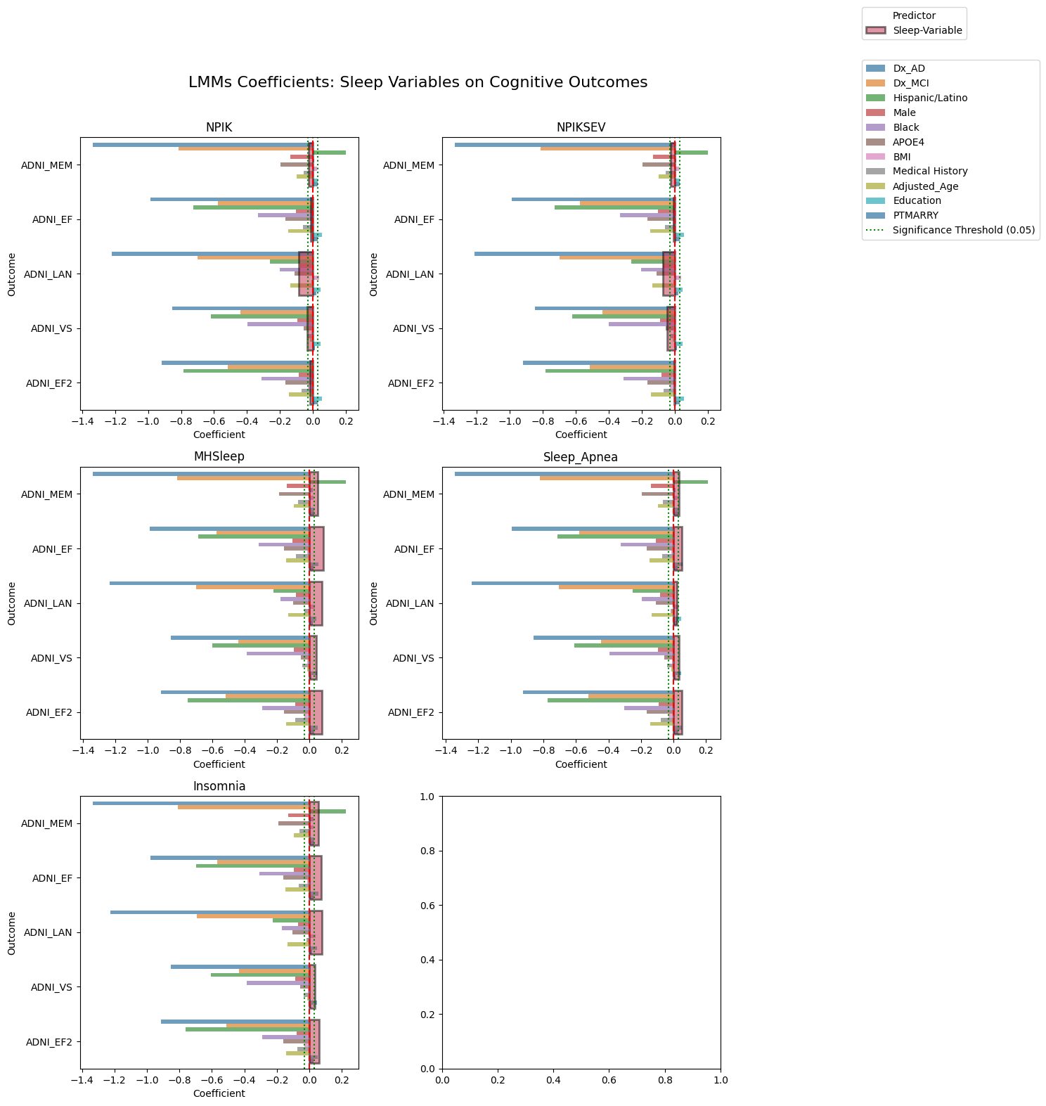
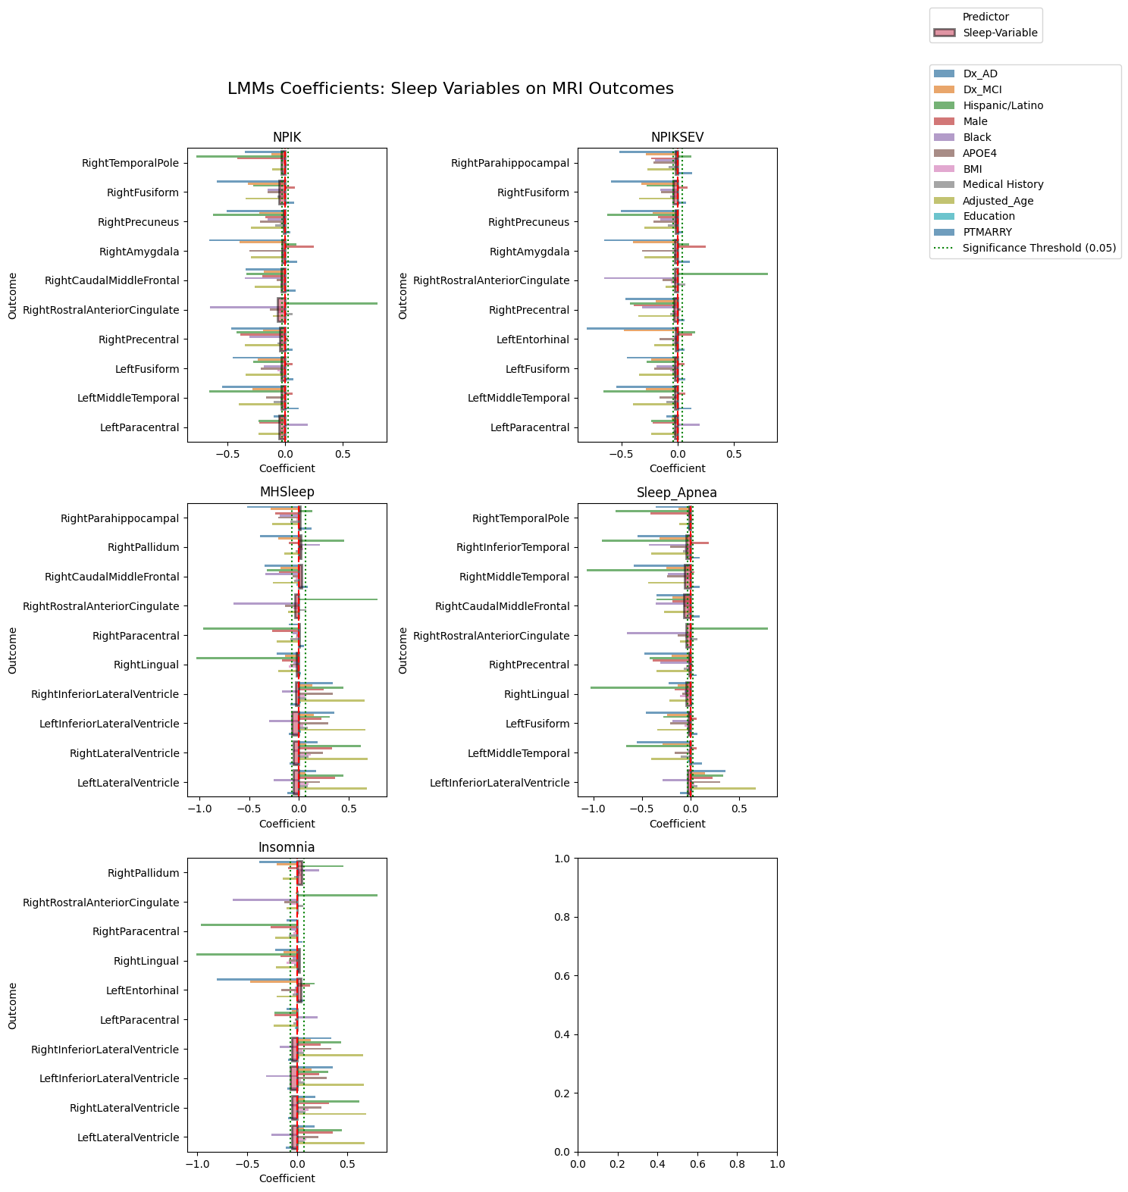
Longitudinal Analysis (Model-2)

Slide 15
Significance (Model-2)
 | NPIK | NPIKSEV | MHSleep | Sleep_Apnea | Insomnia
RightEntorhinal | 0.011 | -0.004 | 0.054 | 0.011 | 0.068*
RightTemporalPole | -0.033 | -0.014 | 0.066 | -0.015 | 0.085*
RightParahippocampal | -0.003 | -0.021 | 0.016 | -0.008 | 0.064
RightInferiorTemporal | 0.001 | -0.014 | 0.099* | -0.042 | 0.148*
RightMiddleTemporal | -0.014 | -0.016 | 0.049 | -0.062 | 0.102*
RightFusiform | -0.052* | -0.040* | 0.117* | 0.038 | 0.099*
RightInferiorParietal | -0.006 | -0.002 | 0.152* | 0.065 | 0.119*
RightIsthmusCingulate | -0.012 | -0.011 | 0.082* | 0.027 | 0.056
RightBankssts | -0.006 | -0.012 | 0.057 | 0.022 | 0.059
RightPrecuneus | -0.015 | -0.018 | 0.096* | 0.018 | 0.101*
RightHippocampus | -0.002 | -0.008 | 0.092* | 0.027 | 0.098*
RightAmygdala | -0.025 | -0.027 | 0.109* | 0.029 | 0.093*
RightAccumbensArea | 0.023 | 0.003 | 0.104* | 0.008 | 0.087*
RightMedialOrbitofrontal | 0.033 | 0.017 | 0.090* | 0.014 | 0.086*
RightPallidum | 0.099 | 0.072* | 0.022 | 0.008 | 0.043
RightCaudalMiddleFrontal | -0.033 | -0.012 | 0.027 | -0.066 | 0.086*
RightPutamen | 0.057* | 0.020 | 0.110* | 0.064 | 0.071
RightRostralAnteriorCingulate | -0.063 | -0.026 | -0.039 | -0.042 | -0.001
RightParacentral | 0.012 | 0.008 | 0.002 | 0.011 | 0.002
RightPrecentral | -0.047 | -0.035 | 0.046 | -0.015 | 0.066
RightLingual | 0.015 | 0.021 | -0.024 | -0.044 | 0.025
LeftEntorhinal | -0.014 | -0.020 | 0.051 | 0.036 | 0.039
LeftHippocampus | 0.003 | 0.004 | 0.105* | 0.046 | 0.098*
LeftFusiform | -0.034 | -0.023 | 0.062 | -0.024 | 0.092*
LeftMiddleTemporal | -0.034 | -0.025 | 0.068 | -0.009 | 0.089*
LeftParacentral | -0.054 | -0.029 | 0.049 | 0.040 | 0.001
RightInferiorLateralVentricle | 0.029* | 0.036* | -0.034 | -0.004 | -0.056
LeftInferiorLateralVentricle | 0.028 | 0.031* | -0.071 | -0.027 | -0.069
RightLateralVentricle | 0.016 | 0.019* | -0.055 | -0.003 | -0.055
LeftLateralVentricle | 0.013 | 0.017* | -0.056 | -0.007 | -0.052
 | NPIK | NPIKSEV | MHSleep | Sleep_Apnea | Insomnia
ADNI_EF | -0.01 (p=0.651) | -0.01 (p=0.657) | 0.09 (p=0.006)* | 0.05 (p=0.097) | 0.07 (p=0.018)*
ADNI_EF2 | -0.02 (p=0.540) | -0.00 (p=0.758) | 0.08 (p=0.016)* | 0.05 (p=0.125) | 0.06 (p=0.058)
ADNI_LAN | -0.08 (p=0.006)* | -0.07 (p=0.000)* | 0.08 (p=0.012)* | 0.02 (p=0.459) | 0.08 (p=0.009)*
ADNI_MEM | -0.03 (p=0.308) | -0.03 (p=0.119) | 0.05 (p=0.045)* | 0.04 (p=0.182) | 0.05 (p=0.039)*
ADNI_VS | -0.03 (p=0.486) | -0.05 (p=0.135) | 0.04 (p=0.183) | 0.03 (p=0.302) | 0.03 (p=0.288)

Slide 16
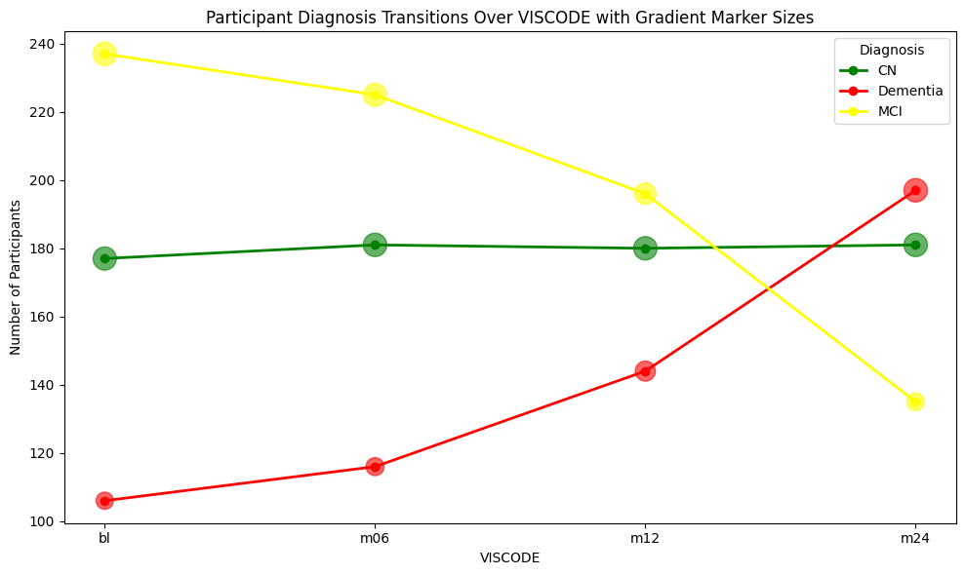
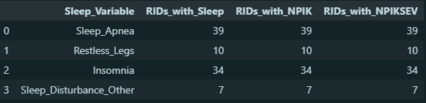
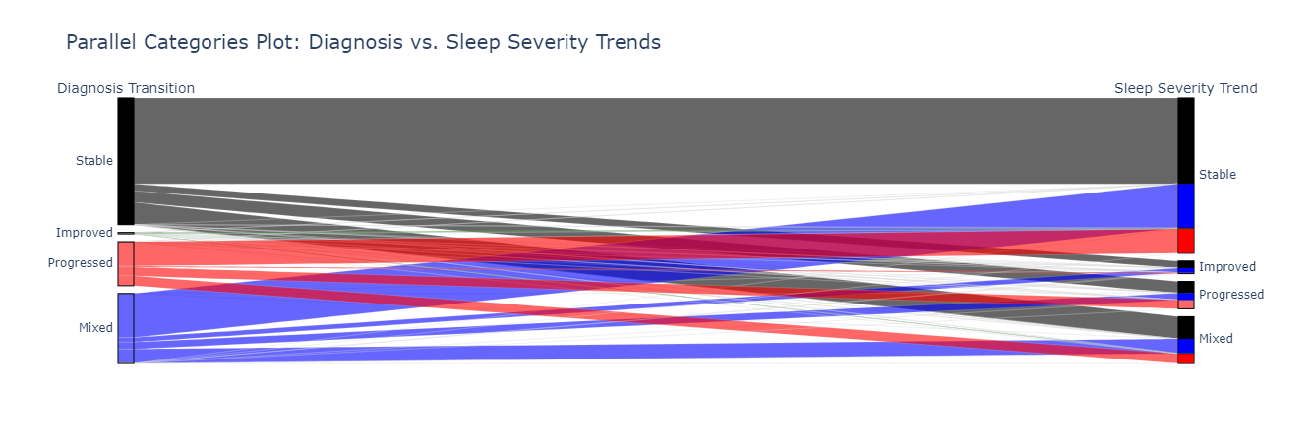
Longitudinal Trend
All participants with sleep disorder has bad sleep quality.
All participants with bad sleep quality does not have a sleep disorder

Slide 17
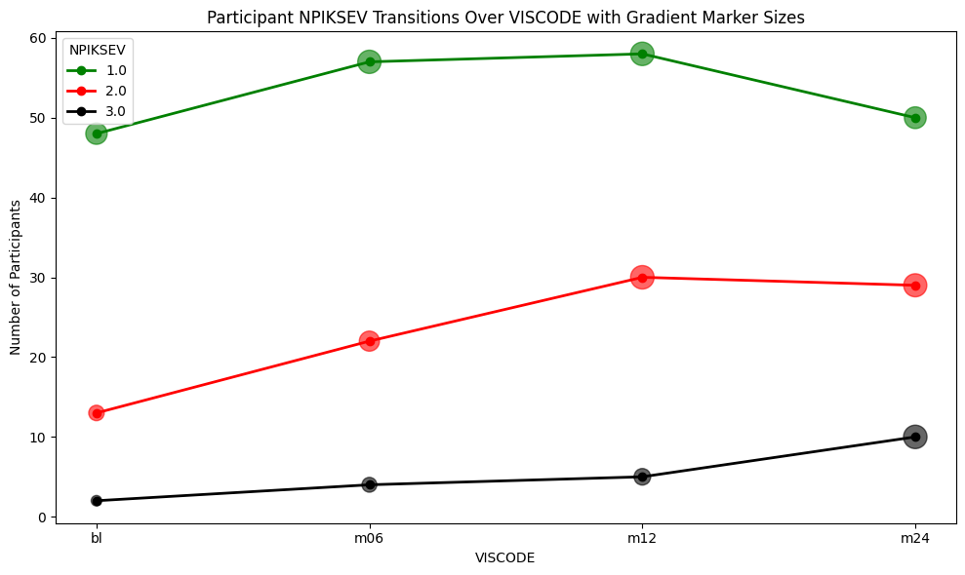
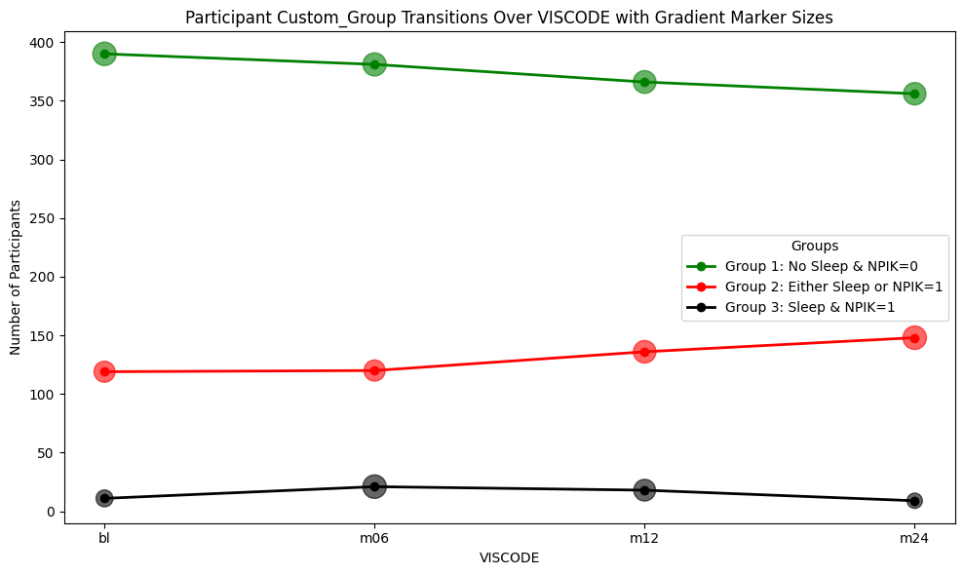

Slide 18
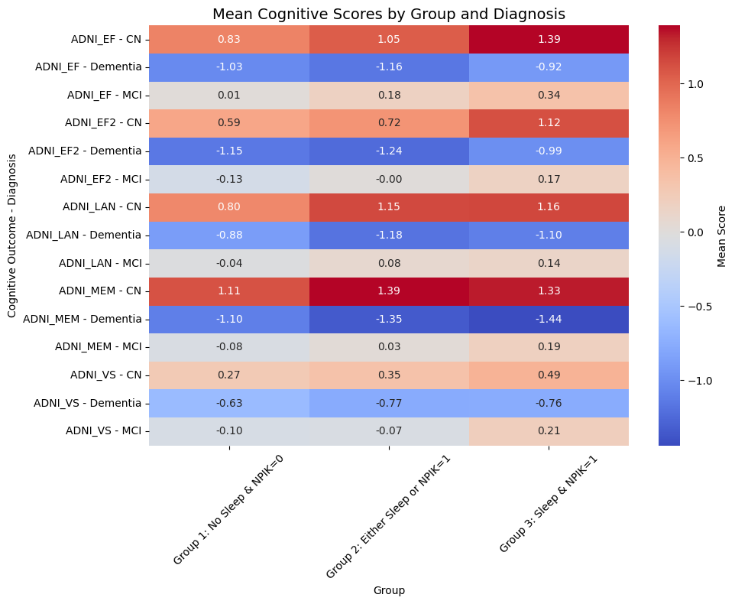
Mean and Correlation of Cognitive Outcomes across subgroups
 |  | Group 1: No Sleep & NPIK=0 | Group 2: Either Sleep or NPIK=1 | Group 3: Sleep & NPIK=1
ADNI_EF | CN | 0.83 | 1.05 | 1.39
 | Dementia | -1.03 | -1.16 | -0.92
 | MCI | 0.01 | 0.18 | 0.34
ADNI_EF2 | CN | 0.59 | 0.72 | 1.12
 | Dementia | -1.15 | -1.24 | -0.99
 | MCI | -0.13 | -0.00 | 0.17
ADNI_LAN | CN | 0.80 | 1.15 | 1.16
 | Dementia | -0.88 | -1.18 | -1.10
 | MCI | -0.04 | 0.08 | 0.14
ADNI_MEM | CN | 1.11 | 1.39 | 1.33
 | Dementia | -1.10 | -1.35 | -1.44
 | MCI | -0.08 | 0.03 | 0.19
ADNI_VS | CN | 0.27 | 0.35 | 0.49
 | Dementia | -0.63 | -0.77 | -0.76
 | MCI | -0.10 | -0.07 | 0.21

Slide 19
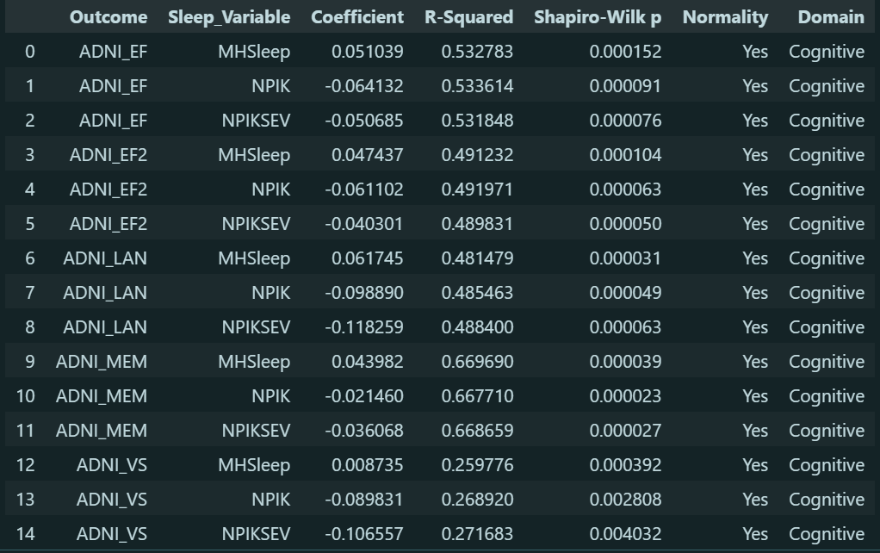
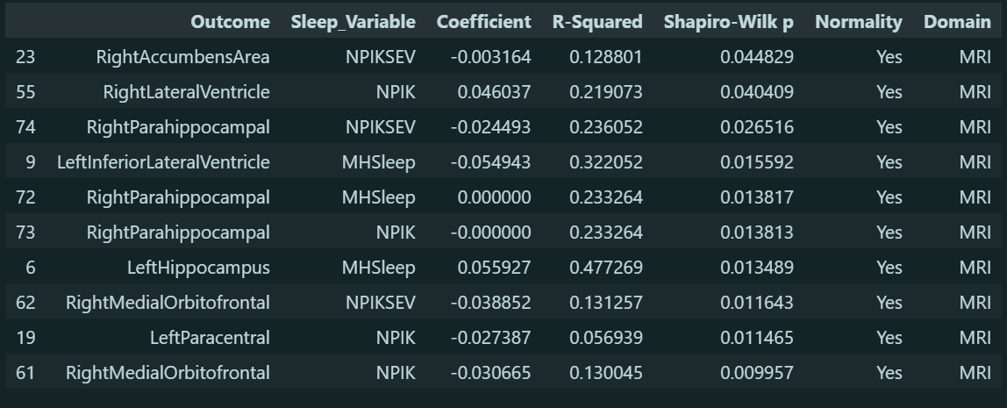
Cross-sectional Post Model (ANOVA and Normality test)

Slide 20
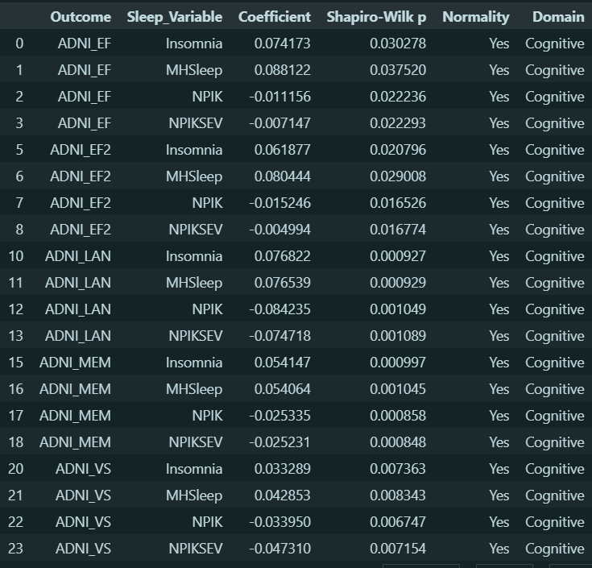
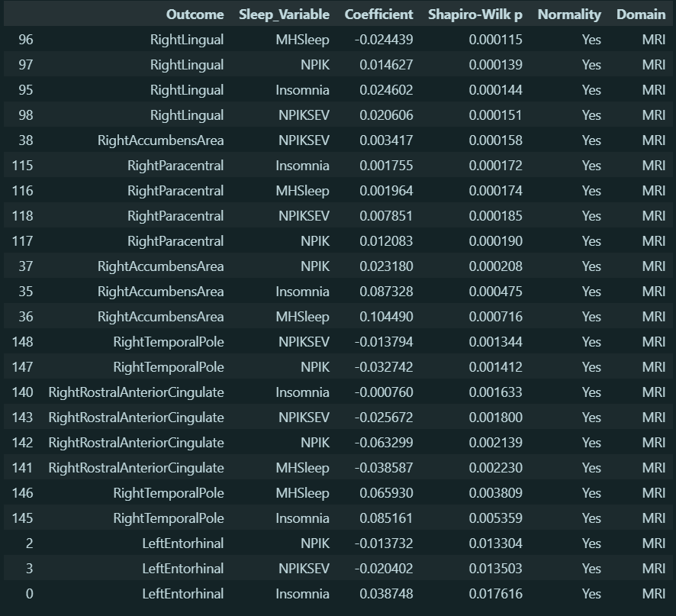
Longitudinal Post Model (ANOVA and Normality test) [Model-2]

Slide 21
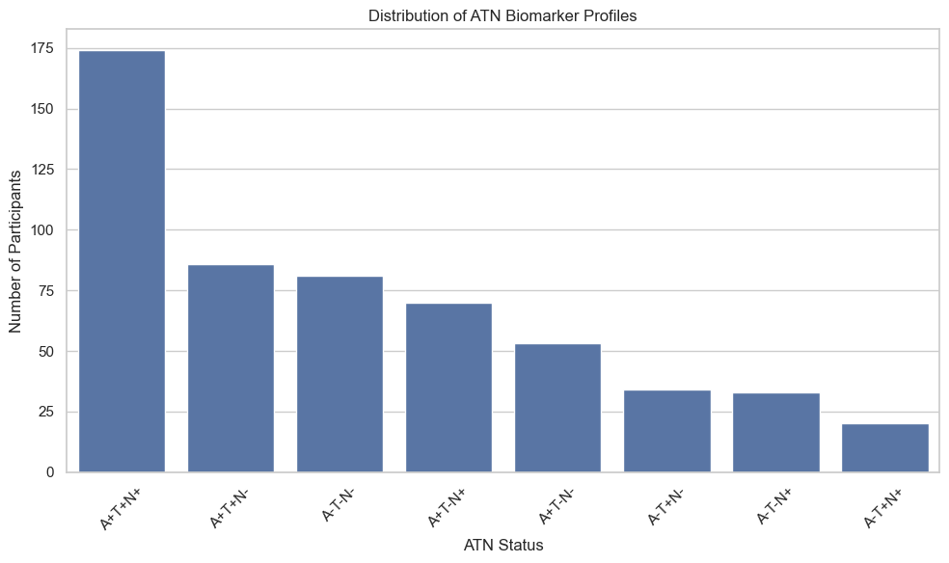
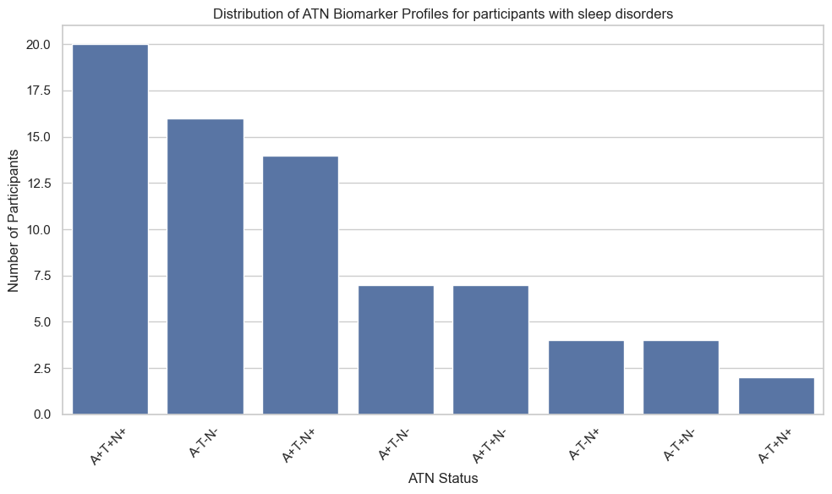
ATN Relevance
A (amyloid): A+ = elevated amyloid, A- = normal
T (PTau): P+ = abnormal phosphorylated tau, T- = normal
N (Neurodegeneration): N+ = atrophy, N- = normal
A+T+N+: Most prevalent → these participants show the most AD trajectory.
Most participants out of 79, 20 participants has A+T+N+
Out of 79, ~16 participants has A-T-N-

Slide 22
Results
Positive coefficient → Sleep variable associated with better outcome
Negative coefficient → Sleep variable associated with worse outcome
Sleep Apnea and RLS showed negative associations with cognitive outcomes, especially Memory and executive function, even after adjusting for covariates.
Sleep disturbances may correlate with the covariates and adjusting for them may artificially flip the direction of effect.
Some individuals with insomnia may have hyper aroused brains which preserve cognitive function better.
mild restless legs could increase motor activity and cerebral perfusion, indirectly benefiting brain health in early aging stages.
Directionally opposing effects of sleep variables do not necessarily imply a real protective effect but they more likely reflect biases. [Result taken from Cross-sectional study]

